Slide 1

SMART TV AND APIs
INTEGRATION
By Daisy LaFlamme

Slide 2

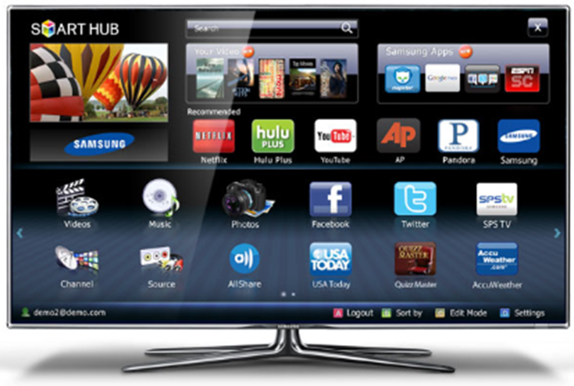
Sources of apps
Smart phones
Ipads
Computers
Smart TVs

Slide 3
Samsung Internet@TV
Platform that aims to bring content from the Internet into people's living rooms through certain Samsung televisions and Blu-ray players. The system uses HTML “widgets” to bring an app like experience to the TV set. Developers need only HTML, CSS and Javascript skills.

Slide 4
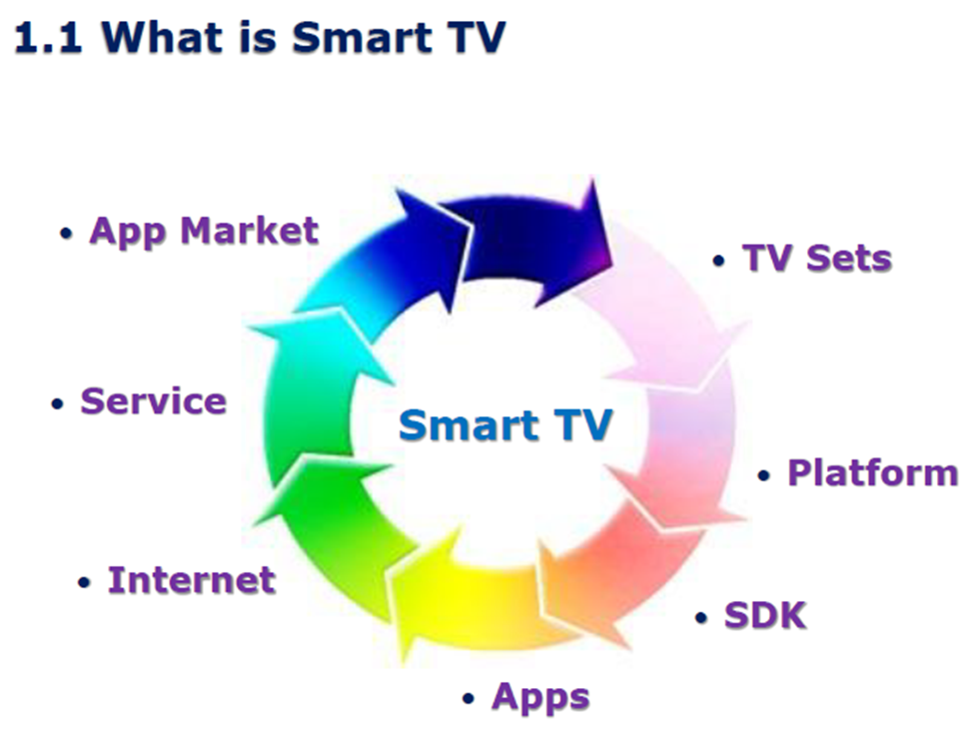

Slide 5
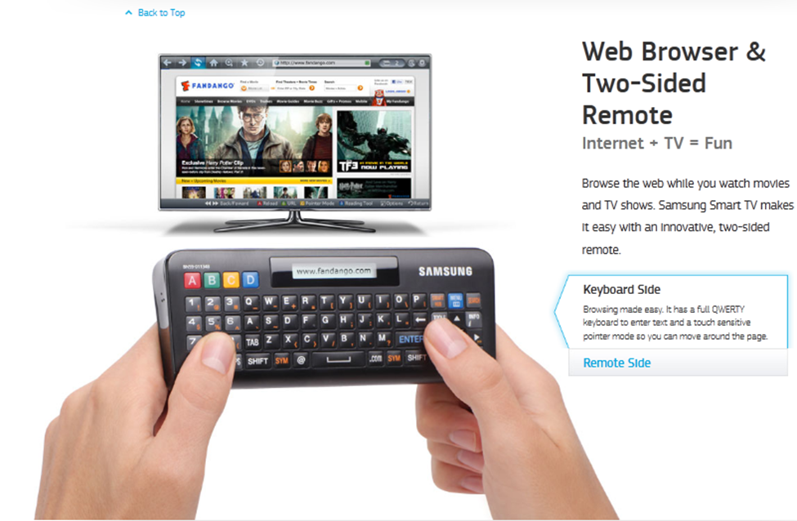

Slide 6
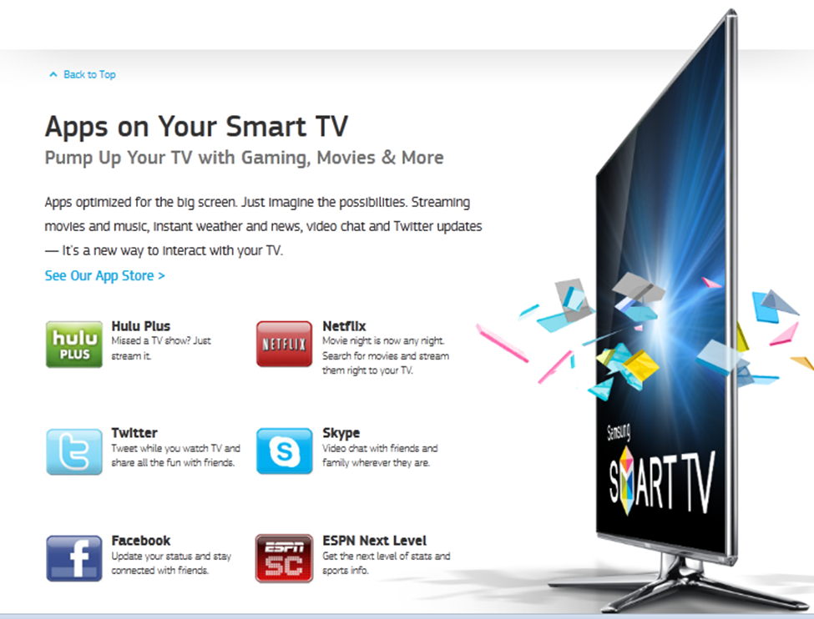

Slide 7
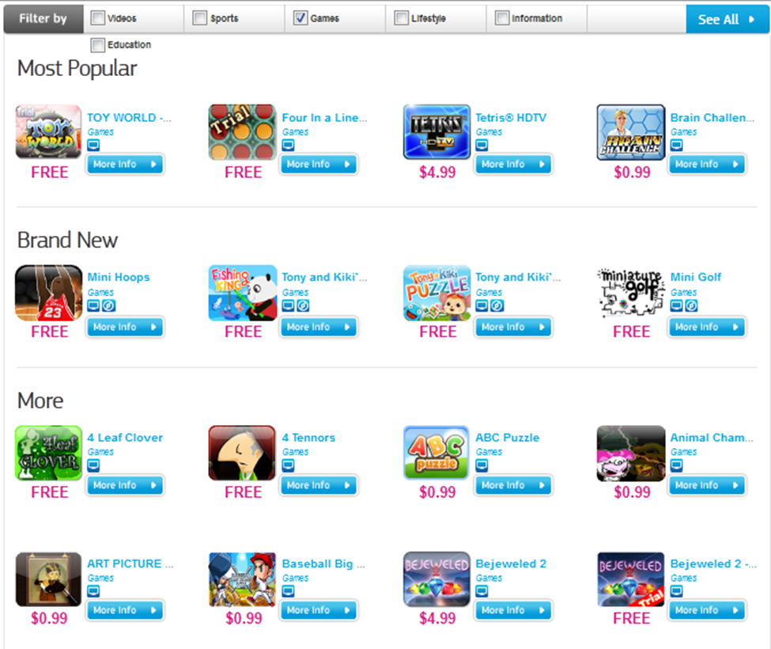
Samsung TV App store – Smart Hub

Slide 8
BADA
Bada (stylized as bada; Korean: 바다) is an operating system for mobile devices such as smartphones and tablet computers. It is developed by Samsung Electronics. Its name is derived from "바다 (bada)", meaning "ocean" or "sea" in Korean. It ranges from mid-range to high-end smartphones.
To foster adoption of Bada OS, Samsung is reportedly considering releasing the source code under an open-source license, and expanding device support to include Smart TVs. Samsung has announced it will merge Bada into the Tizen project.

Slide 9

SDK
Samsung provides a well equipped SDK and tool set, as well as substantial documentation to give you a solid start-up. Check out www.samsungdforum.com. However, keep in mind that only US developers are currently allowed to submit TV apps into the store. Let’s hope this changes soon In SDK Samsung provides various documents & sample tutorials for creating different apps by using Samsung platform APIs..

Slide 10
What TV’s apps are?
Applications are basically web apps (HTML, JavaScript) with extensive APIs providing access to various functionalities of the (Linux 2.6 based) device. For completeness sake, we should point out that Adobe SWF and Lua Script apps are also supported.
If the TV was made in 2011 it will be able to utilize the latest web futures: CSS3 and HTML5.

Slide 11
Developers are provided with access to APIs
File storage API (with poor security),
TV Key API (for remote control),
External Device API (for access to devices such as the Blu-ray player) as well as native image and video players.

Slide 12
Device convergence
area where Samsung sees great value (and it’s difficult to disagree!), especially between the Smart TV and the Galaxy family led by the highly successful Galaxy S II. The Interactive Mobile Device App API was designed specifically to support such solutions. Galaxy owners can already try out Samsungs Smart View mobile app which demonstrates some really innovative solutions, such as content streaming from the TV to multiple mobile devices!.

Slide 13
Samsung Smart TV API Reference
JavaScript APIs
Samsung Smart TV provides the following APIs:
AllShare API
Provides the interfaces to access media proviers
AppsFramework APIs
Includes Framework API, Service API, and UI Components API.
Common Modules
Provides common object modules that all applications can use.
Convergence App API
Allows devices supporting the HTTP protocol to communicate with the Smart TV.
File API
Provides the interfaces for using a file input/output system to store data.
Interactive Remote API
Enables applications to allow their Samsung Smart TV to interact with other devices such as smart phones.
Web Device API
Web Device API is used by applications when the JavaScript function does not support a certain TV function (for example, channel change). Samsung Engine has many TV modules, and Web Device API is the entry point to them for the application. The Web Device API includes:
Common Web Device API
DTV Web Device API

Slide 14
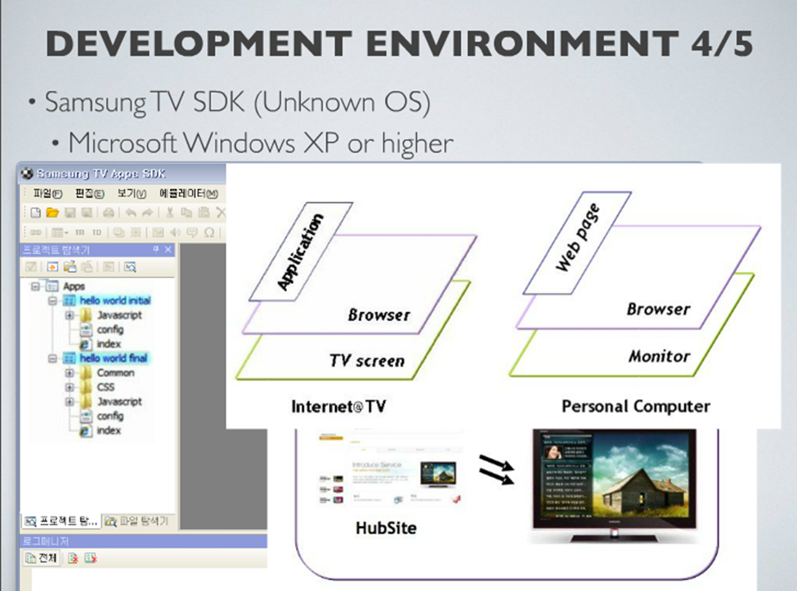

Slide 15
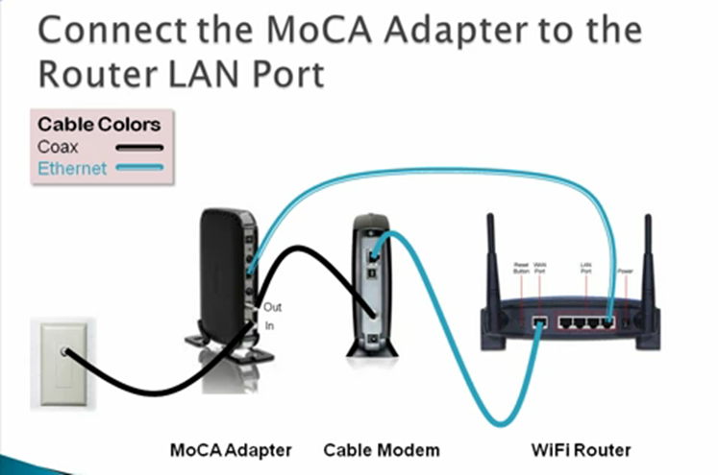
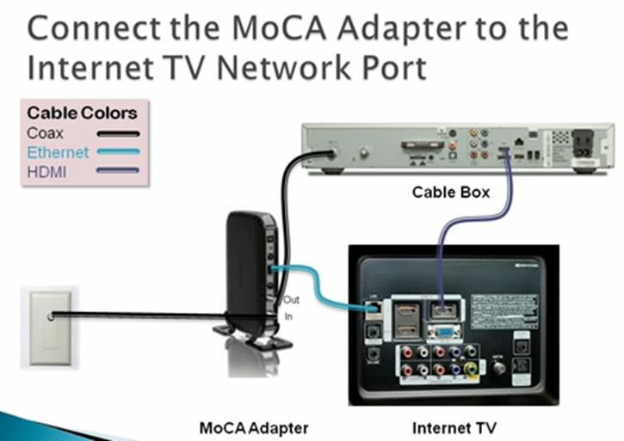

Slide 16
How to build a simple “Hello World” app
Installation of SDK (Within the SDK you get four tools: a visual designer, an integrated development environment, an emulator of the Internet@TV system and a copy of the Apache Web Server.)
The browser on these systems is called MAPLE (Markup engine Platform for Embedded Systems )

Slide 17
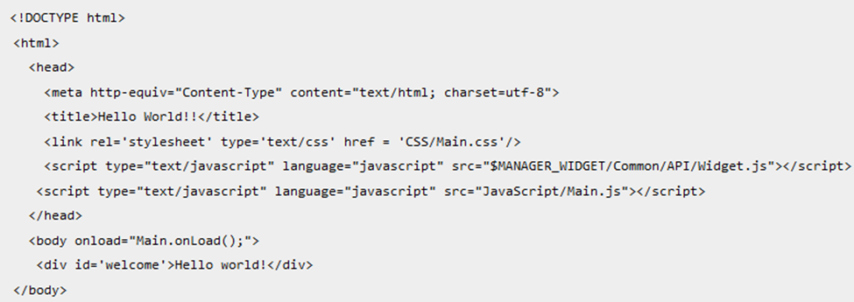
index.html file

Slide 18
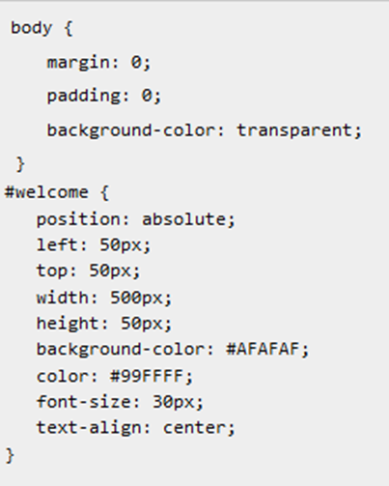
main.css file

Slide 19
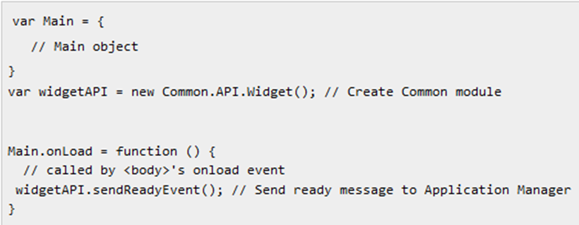
main.js file
We need to call a Javascript function on the machine to tell it that our page is ready to be displayed
The method sendReadyEvent() method notifies the Application Manager that the application is ready to be displayed. This event is passed to the display and the application is run on the screen.

Slide 20
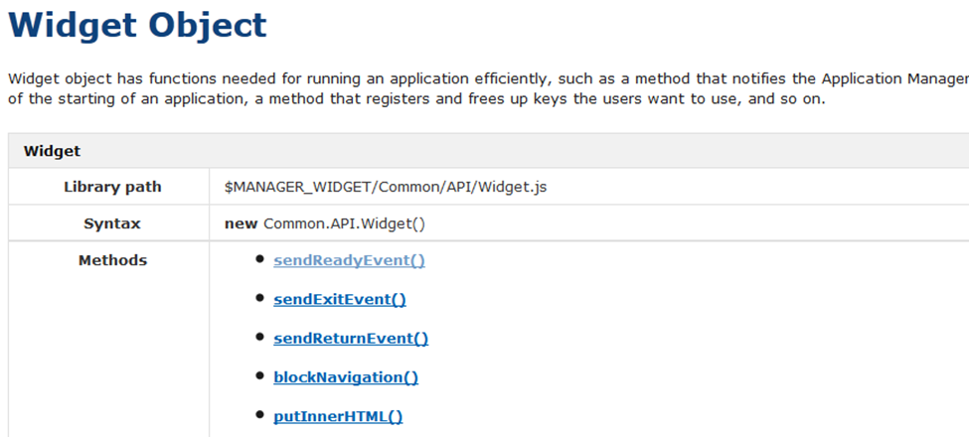
Part of the development API documentation:

Slide 21
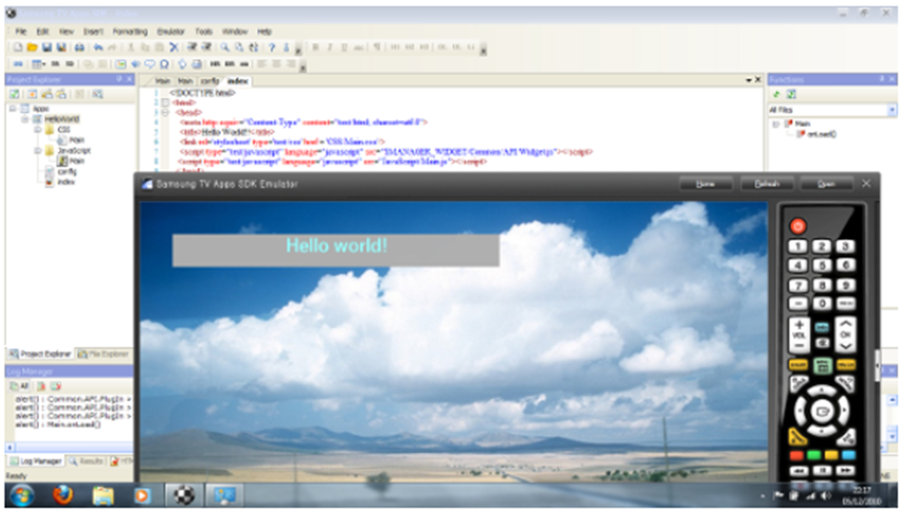
Testing

Slide 22
Smart TV platforms
Samsung Smart TV
LG Smart TV
Google TV
W3C Web on TV
Hbb TV

Slide 23
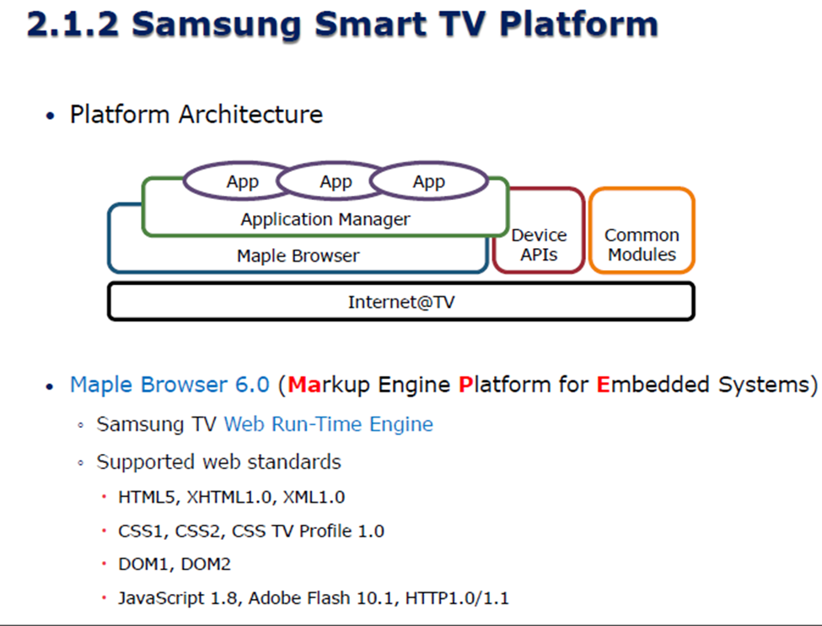

Slide 24
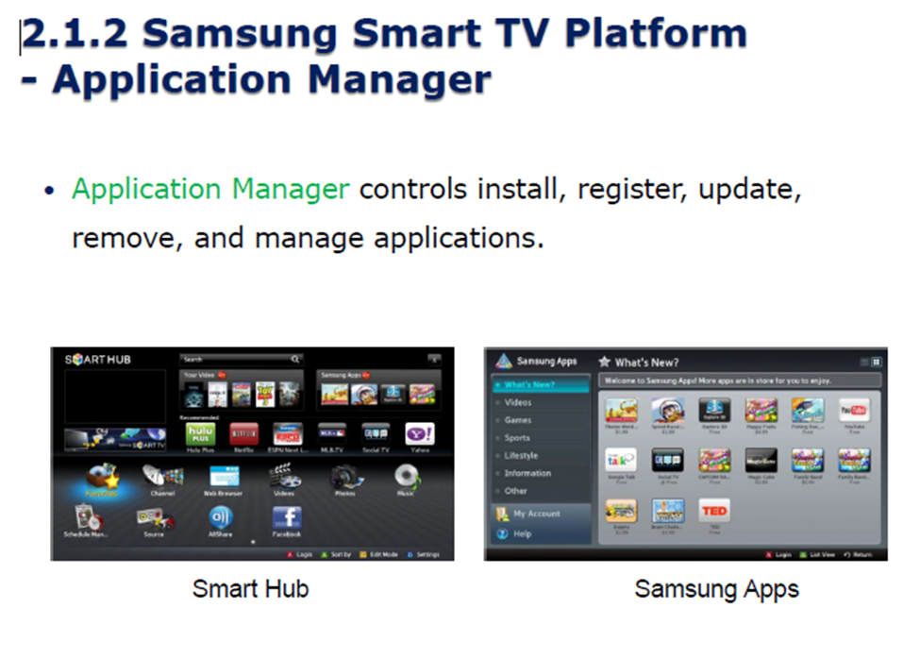

Slide 25
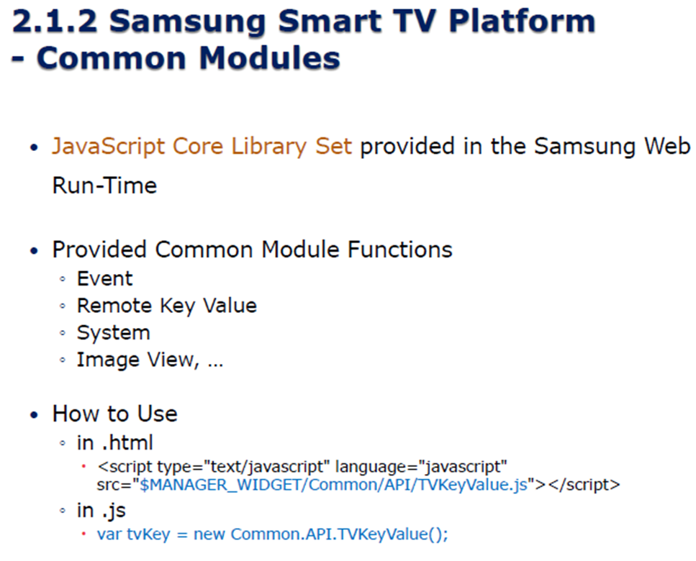

Slide 26
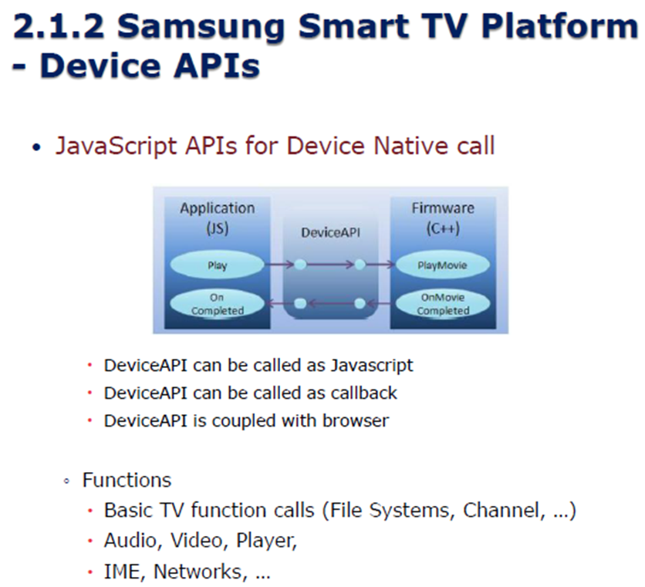

Slide 27
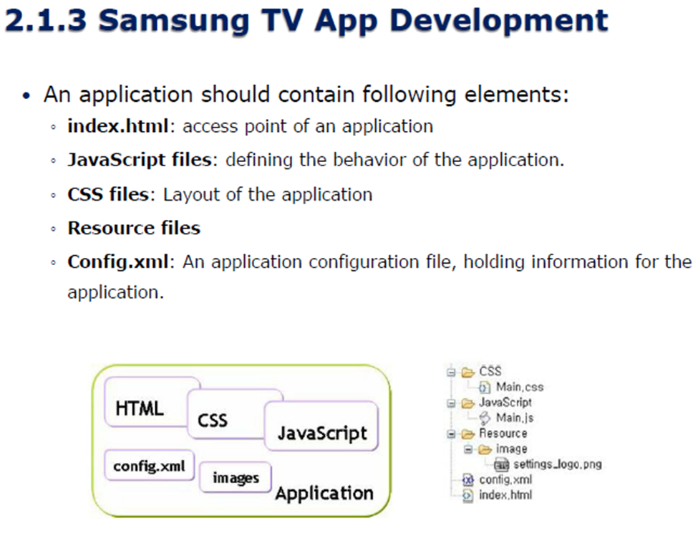

Slide 28
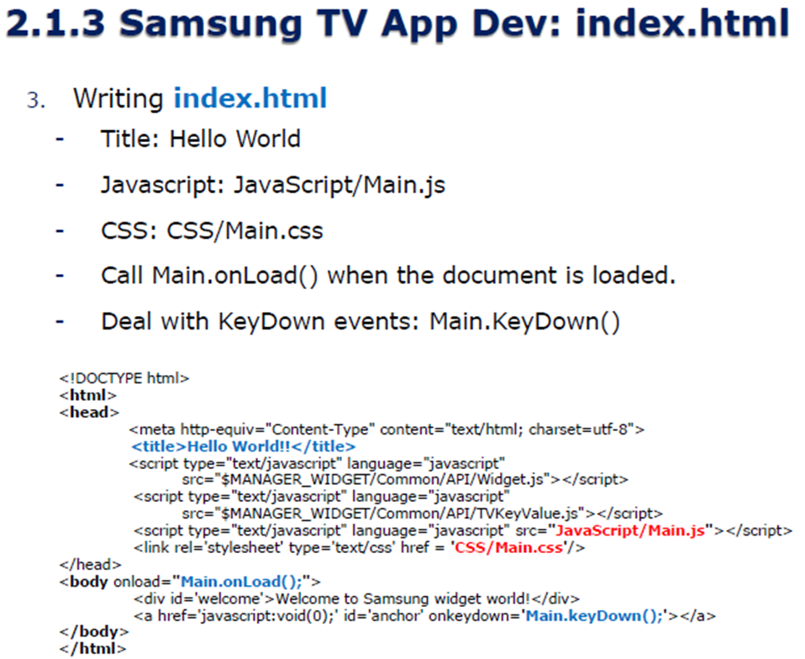

Slide 29
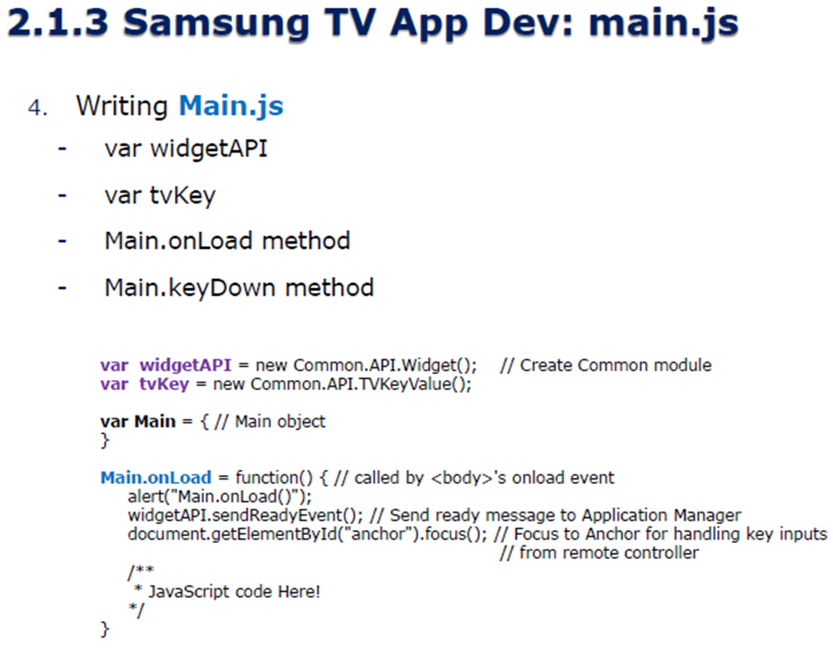

Slide 30
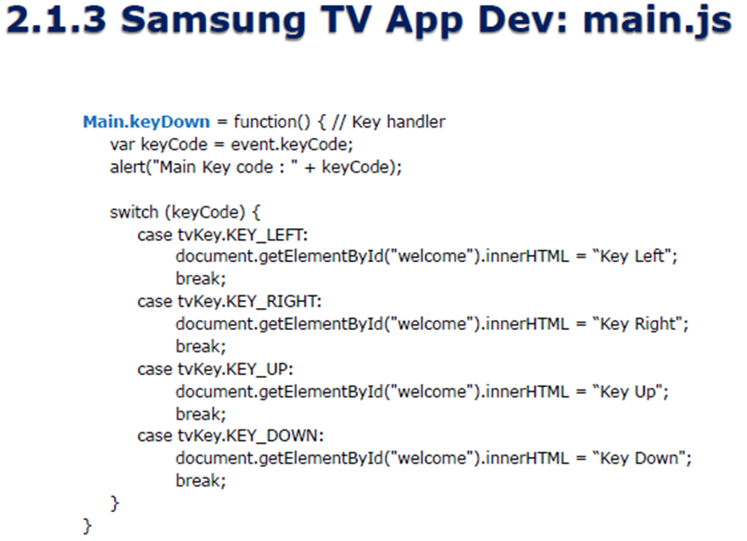

Slide 31
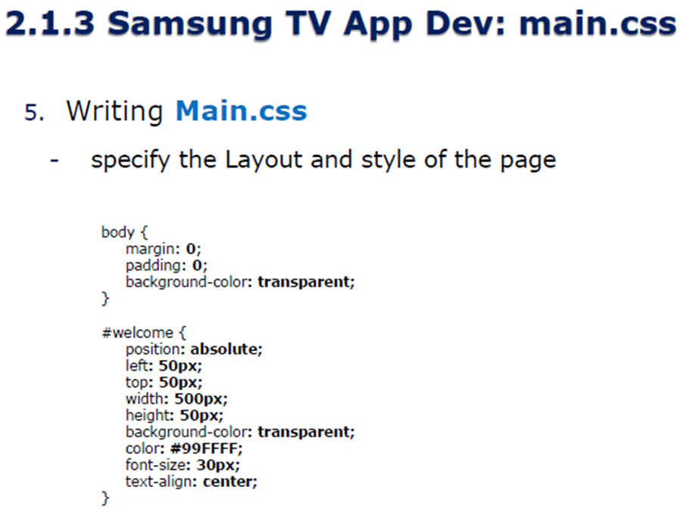

Slide 32
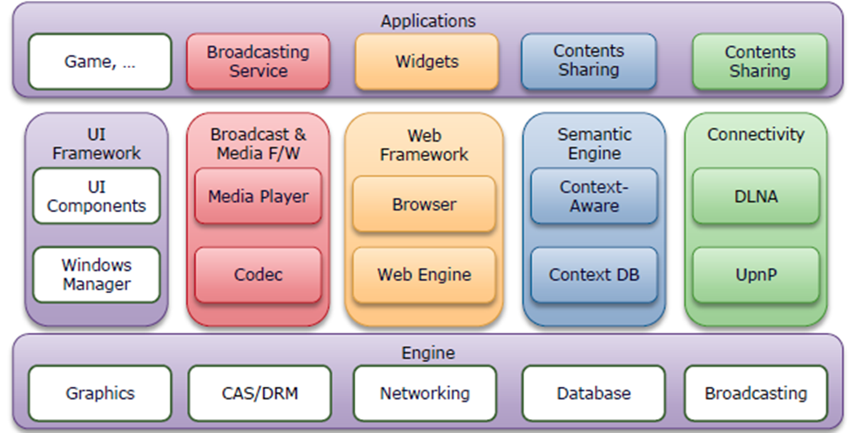

Slide 33
